Slide 1
FLASHCARD APPLICATION
Members:
23K-3021 Mehak
23K-3015 Ayesha Raza
23K-3016 Khadija Atiq

Slide 2

INTRODUCTION
Motivation
The problems we will be catering to will assist students academically and help them to excel
in their exams with our proposed solution.
The era we are living in is taking over the conventional lifestyle therefore students prefer e- learning. We have made a flashcard application. Flashcards help students to engage in active recall or a process wherein students actively engage in learning by stimulating our memories and creating lasting connections to the material therefore, it is a great and an efficient way to learn and is preferred by majority of the students.
We create the cards with questions on one side and answers on the other, students can hide the answer while revising and they can be displayed when needed.
What is a Flashcard?
We create the cards with questions on one side and answers on the other, students can hide the answer while revising and they can be displayed when needed.
What is Spaced Repetition?
Spaced repetition involves reviewing information at increasing intervals over time, optimizing memory retention and recall by strategically spacing out learning sessions.

Slide 3



FUNCTIONS & FEATURES
Registration
This is a seamless process designed for new users with a user-friendly interface, individuals can sign up by providing a username and password.
The process guides the user through the registration steps, this sets the stage for an engaging experience ahead.
Login: Once the user sets up his profile, he can log in to the profile at any desired time.
User profiles: These profiles will store the individual’s flashcards giving users a personalized space to continue learning.
Subjects-Topics
Users can effortlessly create and manage custom subjects tailored to their preferences and academic pursuits. The subject system allows users to add and delete subjects whenever they choose to.
We have adapted a hierarchical structure by having subjects and within those subjects there are topics that the user can add within which there will be flashcards.
Flashcards Features
User can remove or add flashcards, topics and subjects according to his need and requirements. These comprehensive features empower users to curate a personalized and dynamic learning environment, fostering engagement and ownership of their educational journey.

Slide 4

1
High Demand Applications
After conducting a research it was found that students prefer to use educational apps for effective learning. Here is the list of the categories that are high in demand currently;
-language learning apps
-coding apps
-math and science learning apps
-exam preparing apps
-and the most important and highly rated category is to do lists and time management applications.
.
Existing Applications and Usage
2
Narrowing down to our interests, apps related to our project belongs to exam preparation applications.
Some of the platforms highly recommended with hefty amount of downloads are "Quizlet" and "AnkiDroid flashcards" with 10 million plus downloads, "StudySmarter" with 5 million plus downloads. the average rating of these apps ranges from 4.4 to 4.6, user reviews the apps as the greatest applications to exists as these platforms are of significant help
MARKET RESEARCH

Slide 5
HOW LEARNING IS CHANGING
The above graph shows the significant rise of the learners that signed up for e learning applications , the number is still rising and it is predicted by 2030 online learning will be the topmost resource replacing the hardcopies and conventional ways of learning.

Slide 6
FUTURE PROSPECTS
if we want to pursue it in future as a source of income or set up as our business then few amendments will be made accordingly, debugging system will be introduced for smoother user's experience, it should be deployed to app stores for certification and approval and feedback from users should be collected and considered for improvements.
Paid Features
Additional features are:
focus mode: we will introduce pomodoro; which will block the distracting apps, user can also opt for ultimate focus mode which will stop user to switch to other apps.
reminders: user will be notified at the time of his choice to review and practice the cards.
personalized plan: if user needs personal assistance, they will be provided with personal plan based on their requirements and feasibility
More
practice questions: considering user's flashcard and subject and on further inquiries, user will be given practice questions to ace perfect score in their exams.
customizable cards: last but not the least, user will be able to customize his own card according to his interests and preferences.
option to quiz yourself is added to make learning more interesting and users to be more serious about their academics, remarks will be generated upon the evaluation of the quiz.
Improving User Experience
Free Features
before proceeding to these steps, we will be adding decent number of features in our existing project to facilitate students, some of the features that will be accessible for all users will be categorizing decks and its management, different card styles, synchronization across devices, spaced time repetition, cards will be available offline, support for multimedia and at last user's progress.

Slide 7
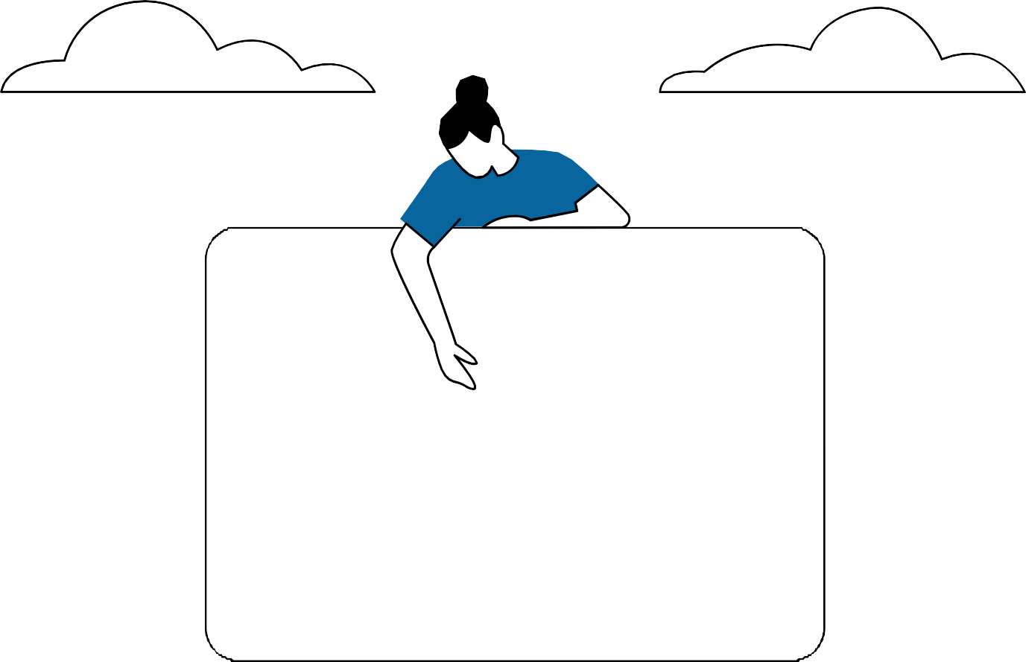





CONCLUSION
Impact our project could make
this application will help us to
achieve our aim to create ease for learners
we will be considering the reviews of the similar available applications on app stores, and try our best to prevent the issues mentioned, in our system.

